Slide 1
Equivariant A-twisted GLSM and Gromov-Witten invariants
Yutaka Yoshida (KIAS →RIMS, Kyoto Univ.)
Autumn Symposium on String theory@KIAS
Based on joint works with
Bumsig Kim (KIAS), Jeongseok Oh (KAIST), Kazushi Ueda (Univ. of Tokyo)
Ueda and YY arXiv:1602.02487 [hep-th]
Kim, Oh, Ueda and YY arXiv:1607.08317 [math.AG]
and also a work with Hee-Joong Chung (KIAS)
Chung and YY arXiv:1605.07165 [hep-th]

Slide 2
Heterotic string theory compactified by a CY 3-fold X with standard
embedding, there are 4 types of Yukawa coupling

Slide 3
Heterotic string theory compactified by a CY 3-fold X with standard
embedding, there are 4 types of Yukawa coupling
B-model Yukawa coupling

Slide 4
Heterotic string theory compactified by a CY 3-fold X with standard
embedding, there are 4 types of Yukawa coupling
B-model Yukawa coupling
A-model Yukawa coupling

Slide 5
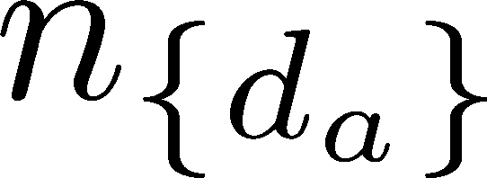
Heterotic string theory compactified by a CY 3-fold X with standard
embedding, there are 4 types of Yukawa coupling
B-model Yukawa coupling
A-model Yukawa coupling
The second term in is non-perturbative corrections
by world sheet instantons
Integer is instanton number with degree

Slide 6
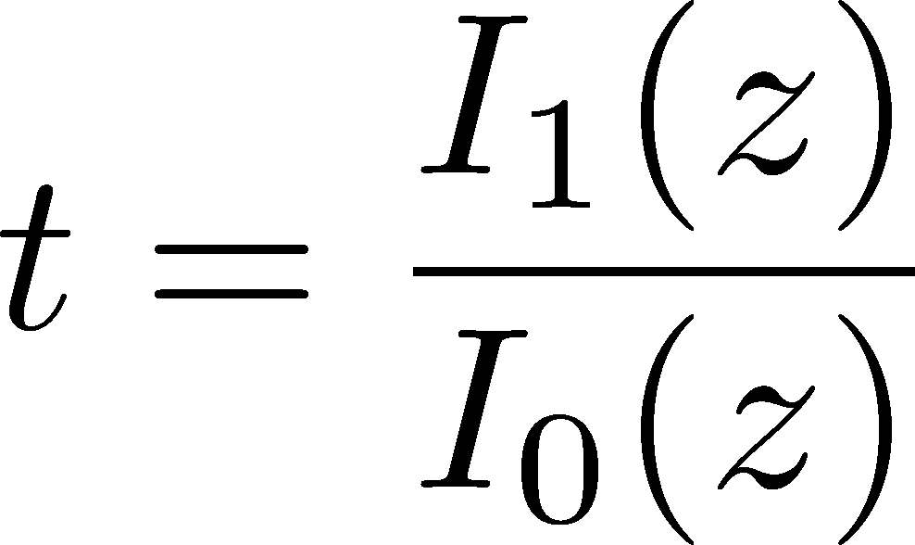
Classical mirror symmetry
Candelas et al (1991) conjectured that
A-model Yukawa coupling is given by
Mirror map
Period integrals of mirror manifold

Slide 7
How to compute B-model Yukawa coupling ?
[Closset-Cremonesi-Park 15, Benini-Zaffaroni 15, see also Morrison-Plesser 94]
Conjectured formula
σ: scalar in A-twisted N=(2,2) vector multiplet
X: Higgs branch vacua of GLSM
z : exponential of complexified FI-parameter (complex structure moduli)
: omega-background parameter
How to compute two period integrals ?
(What is the Interpretation of equivariant A-twisted GLSM ?)

Slide 8
This conjectured formula also works for non-Abelian GLSM
(CY 3-folds in Grassmannians) [CCP 15 ]
For examples
CY 3-folds X defined as zero loci of sections of
over Grassmannians [Batyrev et al 97]
(Realization as a phase of GLSM [Witten 93, Hori-Tong 06])
Classification of CY 3-folds with single Kahler moduli
defined as zero loci of sections of homogenous vector bundles
over Grassmannians [Inoue-Ito-Miura 16]

Slide 9
Plan of talk
Mirror symmetry and B-model Yukawa coupling
2d N=(2,2) GLSM and Calabi-Yau 3-folds
Equivariant A-twist and SUSY localization
Seiberg like dualities
Summary

Slide 10
2d N=(2,2) GLSM and Calabi-Yau 3-folds

Slide 11
2d N=(2,2) Abelian GLSM, Calabi-Yau 3-folds in projective space and NLSM
U(1) vector multiplet
Chiral multiplet with gauge charge
We impose axial anomaly cancelation condition (CY condition)
Action (without superpotential)
Potential term (D-term)

Slide 12
Example of axial anomaly free model
⇒N=(2,2) GLSM flows to N=(2,2) NLSM with target space X in IR

Slide 13
Super potential
G is deg m homogenous polynomial and define a section of O(m)
Target space is given by
Degree m hypersurface in projective space
(compact CY (m-2)-fold )

Slide 14
N=(2,2) GLSM and Calabi-Yau 3-folds in Grassmann manifolds Gr(n,m)
U(n) vector multiplet
m chiral multiplets with fundamental rep of U(n)
Introduce chiral multiplets to cancel axial anomaly
Higgs branch vacuum (positive FI-parameter, appropriate rep )

Slide 15
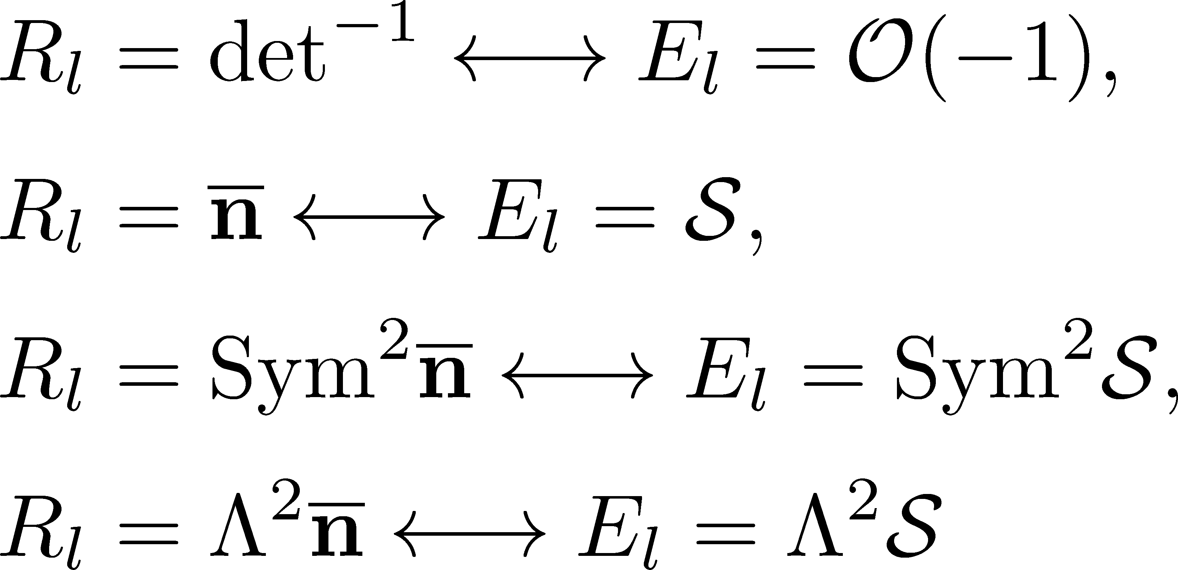
Relations between gauge representations and homogenous vector bundles are following
Superpotential

Slide 16
Higgs branch vacua with positive FI-parameter
define following compact CY manifolds in Grassmannians
The dimension of manifold
Examples of CY 3-folds
These CY 3-folds belong to the classification by Inoue et al
(There are about 20 CY 3-folds)

Slide 17
Equivariant A-twist and SUSY localization

Slide 18
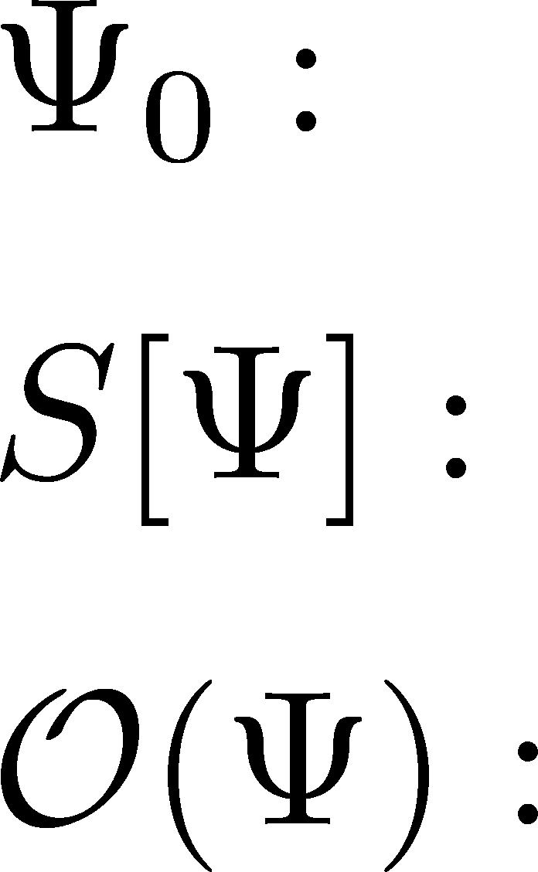
Rigid supersymmetries on
curved spaces and SUSY localization
Construction of SUSY background on curved spaces
1-loop computation around the zero loci of
Q-exact action
Saddle points of Q-exact action
Q-closed action
Q-closed operator

Slide 19
construction of SUSY background on Riemann surfaces
[Closset-Cremonesi 14]
SUSY background ⇔ non-trivial solution of
generalized Killing spinor equations
There are two type of solutions on S2
Equivariant A-twist solution
Another solution[Benini-Cremonesi, Doroud et al 12]

Slide 20
one-loop computation
[CCP 15, BZ 15 ]
Q-exact action:
Q-closed action:
Q-closed operators: inserted on the north or south pole of S2
Exponential of complexified FI-parameter
1-loop determinants of SYM and chiral multiplets

Slide 21
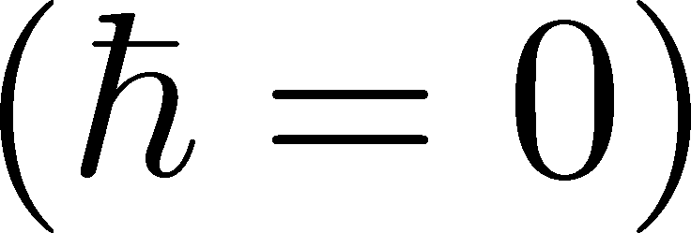
Properties of the localization formula
If equivariant parameter is zero and CY 3-fold condition is satisfied)
Choice of Integer R-charges
If scalars in chiral multiplets parametrize target space
We assign zero R-charge, this R-charge assignment is
consistent with A-twisted NLSM by Witten (1991)

Slide 22
Example 1 (quintic 3-fold)
Example 2 ( local P2 )

Slide 23
Mathematical aspects of the formula
Toric case (gauge groups is U(1))
This contour integral expression is formulated as integrals of divisors over quasi maps [Batyev-Materov 02, 03], [Szenes-Vergne 04, 06, Borisov 05, Karu 05],
Grassmannian cases (gauge group is U(n) )
We introduced certain generalizations of quasi map spaces. Then correlation functions agree with
integrals of divisors over these spaces
[Kim-Oh-Ueda-YY 16]

Slide 24
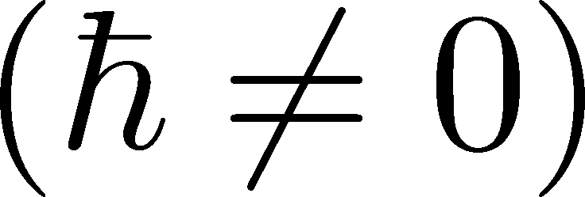
Properties of the localization formula
Here we consider equivariant A-twisted GLSM related to
The CY 3-folds in Grassmannians Gr(n,m)
, the correlation functions are given as

Slide 25
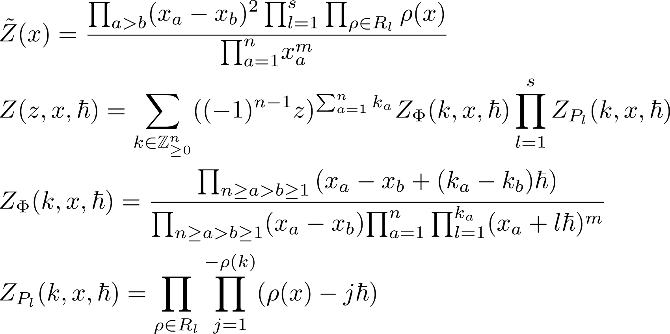
We rewrite generating function of as

Slide 26
When the gauge group is U(1), this expression is same as
Givental’s double construction lemma appeared in his proof of
(classical) mirror symmetry for CY 3-folds in projective space.
Period integrals and mirror map are given by
We expected that this relation also works for U(n) GLSMs
We apply our proposal to CY 3-folds in Grassmannians
and compute GW invariants

Slide 27
Examples
B-model Yukawa coupling

Slide 28
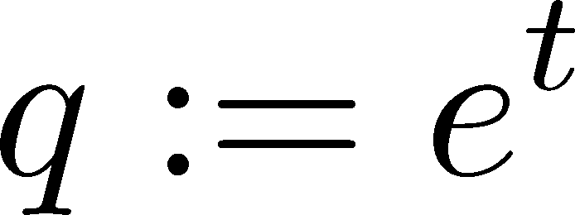
A-model Yukawa coupling
with instanton numbers
These values reproduce instanton numbers of No.212 in CY 3-fold data base by Van Straten
http://www2.mathematik.uni-mainz.de/CYequations/db/

Slide 29
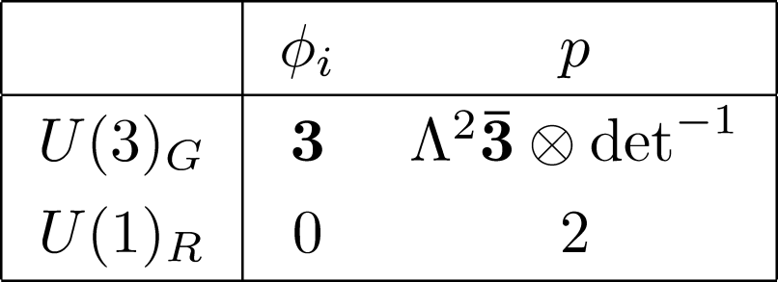
These values reproduce instanton numbers computed by Miura 10
This is a new CY 3-fold found by Inoue et al

Slide 30
Seiberg like dualities

Slide 31
Seiberg like duality and Yukawa coupling
This means
For examples

Slide 32
Mass deformation N=(4,4) theory and quantum cohomology
We studied the relation between of the scalar in the vector multiplet
and the equivariant qunatum cohomology of cotangent bundle of
Grassmannians
We also studied Seiberg like duality for mass deformation
of N=(4,4) theory
We found explicit map of twisted chiral ring elements in the Seiberg
like dual pair

Slide 33
Summary
CY 3-folds in Grassmannians as a phase of GLSM
The relation between equivariant A-twist and math result
Construction of mirror map and computation of GW invariants
future direction and open problems
3d twisted index and quantum K-theory [work in progress]
How to construct mirror map for pfaffian CY 3-folds ?
Other gauge groups ?

Slide 34
Thank you for your attention

