Slide 1
Radiative Generation of the Lepton Mass
Kei Yagyu (National Central U.)
Collaboration with Hiroshi Okada (KIAS)
arXiv: 1311.4360 [hep-ph]
High1-2014,
KIAS-NCTS Joint Workshop on Particle Physics, String Theory and Cosmology
High1 Resort, Feb. 9-15, 2014

Slide 2
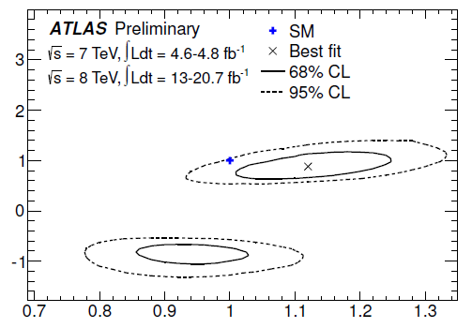
Higgs Discovery
A Higgs boson has been discovered with the mass of 126 GeV.
Mass, CP and signal strengths are consistent with those of
the SM Higgs boson within the error.
So far, Higgs boson couplings are not measured so accurately.
Scaling factors
κ_{V} = g_{hVV} (exp)/g_{hVV} (SM)
κ_{F} = g_{hFF} (exp)/g_{hFF} (SM)
κ_{F}
SM
In particular, Yukawa couplings
have not been measured precisely
(about ±50% error).
κ_{V}

Slide 3
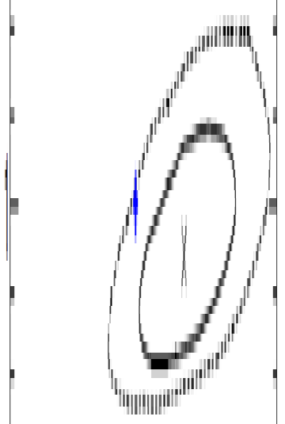
Higgs Discovery
1.4
A Higgs boson has been discovered with the mass of 126 GeV.
Mass, CP and signal strengths are consistent with those of
the SM Higgs boson within the error.
So far, Higgs boson couplings are not measured so accurately.
1.2
Scaling factors
1
κ_{V} = g_{hVV} (exp)/g_{hVV} (SM)
κ_{F} = g_{hFF} (exp)/g_{hFF} (SM)
0.8
κ_{F}
SM
In particular, Yukawa couplings
have not been measured precisely
(about ±50% error).
Higgs discovery ≠ Yukawa interactions have been confirmed.
0.6
κ_{V}

Slide 4
Yukawa Interaction in the SM
In the SM, the Yukawa Lagrangian and coupling are given by
There is the one-to-one correspondence between m_{F} and y_{F}.
ν_{e}, ν_{μ}, ν_{τ}
e
μ
τ
<Φ> (~ mt)
Mass
0.1 eV
0.001 GeV
0.1 GeV
1 GeV
100 GeV
Neutrinos are massless
Coup.
10⁻⁵
10⁻³
10⁻²
1

Slide 5
Yukawa Interaction in the SM
In the SM, the Yukawa Lagrangian and coupling are given by
If we introduce ν_{R} and Dirac neutrino masses (L# cons.), then
We need a too small Yukawa coupling.
ν_{e}, ν_{μ}, ν_{τ}
e
μ
τ
<Φ> (~ mt)
Mass
0.1 eV
0.001 GeV
0.1 GeV
1 GeV
100 GeV
Coup.
10⁻¹²
10⁻⁵
10⁻³
10⁻²
1

Slide 6
Yukawa Interaction in the SM
In the SM, the Yukawa Lagrangian and coupling are given by
We have already introduced tiny Yukawa couplings for c-leptons.
ν_{e}, ν_{μ}, ν_{τ}
e
μ
τ
<Φ> (~ mt)
Mass
0.1 eV
0.001 GeV
0.1 GeV
1 GeV
100 GeV
Coup.
10⁻¹²
10⁻⁵
10⁻³
10⁻²
1

Slide 7
Yukawa Interaction in the SM
In the SM, the Yukawa Lagrangian and coupling are given by
Why lepton masses are so small compared to the EW scale?
ν_{e}, ν_{μ}, ν_{τ}
e
μ
τ
<Φ> (~ mt)
Mass
0.1 eV
0.001 GeV
0.1 GeV
1 GeV
100 GeV
Coup.
10⁻¹²
10⁻⁵
10⁻³
10⁻²
1

Slide 8
Yukawa Interaction in the SM
In the SM, the Yukawa Lagrangian and coupling are given by
Why there is a large hierarchy between masses for neutrinos and charged leptons?
ν_{e}, ν_{μ}, ν_{τ}
e
μ
τ
<Φ> (~ mt)
Mass
0.1 eV
0.001 GeV
0.1 GeV
1 GeV
100 GeV
Coup.
10⁻¹²
10⁻⁵
10⁻³
10⁻²
1

Slide 9
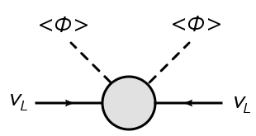
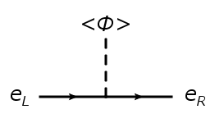
Lepton Masses (Traditional Way)
Majorana neutrino mass
Weinberg (1980)
Tree level : Type-I, II and III seesaw
Loop level : Radiative seesaw models
Dirac c-lepton mass

Slide 10
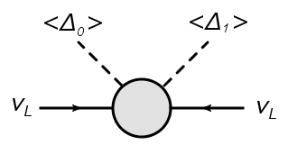
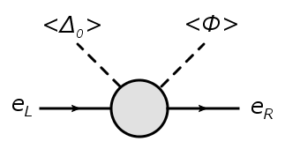
Lepton Masses (Our Idea)
Majorana neutrino mass
Δ_{0,1} : SU(2) triplet Higgs field
v_{Δ} : Triplet VEV
Dirac c-lepton mass

Slide 11
Lepton Masses (Our Idea)
Majorana neutrino mass
Loop
Δ_{i} : SU(2) triplet Higgs field
v_{Δ}, v_{Δ}’ : Triplet VEV, v_{Δ} << v
Dirac c-lepton mass
Loop

Slide 12
Lepton Masses (Our Idea)
Majorana neutrino mass
Why lepton masses are so small compared to the EW scale?
Loop
Δ_{i} : SU(2) triplet Higgs field
v_{Δ} : Triplet VEV, v_{Δ} << v
Dirac c-lepton mass
Smallness is explained by the loop suppression factor and triplet VEVs.
Loop

Slide 13
Lepton Masses (Our Idea)
Majorana neutrino mass
Why there is a large hierarchy between masses for neutrinos and charged leptons?
Loop
Δ_{i} : SU(2) triplet Higgs field
v_{Δ} : Triplet VEV, v_{Δ} << v
Dirac c-lepton mass
Number of triplet VEV is different.
Loop

Slide 14
Model
Symmetry: SU(3)_{c}×SU(2)_{L}×U(1) _{Y}×Z₂(unbroken)×Z₄
To close the loop diagram
+ Stability of DM candidate
To forbid the tree level masses
Particle Content (Z₂-even, Z₂-odd):
Φ Δ₀ Δ₁ Φ_{3/2} η S L^{i} (e_{R}, μ_{R}) τ_{R} E^{α}
SU(2)_{L}
2 3 3 2 2 1 2 1 1 1
U(1)_{Y}
1/2 0 1 3/2 1/2 0 -1/2 -1 -1 -1
Z₄
-i -1 -1 1 1 -i 1 -i +i 1
Scalar bosons
Leptons

Slide 15
Model
Particle Content (Z₂-even, Z₂-odd):
Φ Δ₀ Δ₁ Φ_{3/2} η S L^{i} (e_{R}, μ_{R}) τ_{R} E^{α}
SU(2)_{L}
2 3 3 2 2 1 2 1 1 1
U(1)_{Y}
1/2 0 1 3/2 1/2 0 -1/2 -1 -1 -1
Z₄
-i -1 -1 1 1 -i 1 -i +i 1

Slide 16
Model
Particle Content (Z₂-even, Z₂-odd):
Φ Δ₀ Δ₁ Φ_{3/2} η S L^{i} (e_{R}, μ_{R}) τ_{R} E^{α}
SU(2)_{L}
2 3 3 2 2 1 2 1 1 1
U(1)_{Y}
1/2 0 1 3/2 1/2 0 -1/2 -1 -1 -1
Z₄
-i -1 -1 1 1 -i 1 -i +i 1
e, μ
Φ
e, μ

Slide 17
Model
Particle Content (Z₂-even, Z₂-odd):
Φ Δ₀ Δ₁ Φ_{3/2} η S L^{i} (e_{R}, μ_{R}) τ_{R} E^{α}
SU(2)_{L}
2 3 3 2 2 1 2 1 1 1
U(1)_{Y}
1/2 0 1 3/2 1/2 0 -1/2 -1 -1 -1
Z₄
-i -1 -1 1 1 -i 1 -i +i 1
L
Δ₁
L

Slide 18
Model
Particle Content (Z₂-even, Z₂-odd):
Φ Δ₀ Δ₁ Φ_{3/2} η S L^{i} (e_{R}, μ_{R}) τ_{R} E^{α}
SU(2)_{L}
2 3 3 2 2 1 2 1 1 1
U(1)_{Y}
1/2 0 1 3/2 1/2 0 -1/2 -1 -1 -1
Z₄
-i -1 -1 1 1 -i 1 -i +i 1
Ｌ
Φ
τ

Slide 19
Lagrangian
Masses for E^{α}
Tauon mass
Scalar four point interactions
New Yukawa interactions

Slide 20
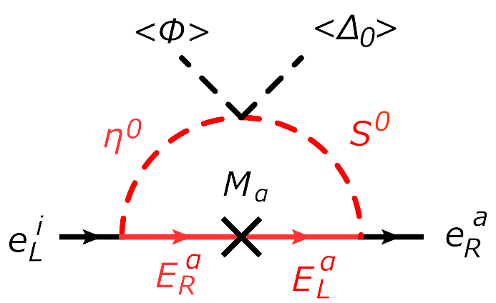
Charged Lepton (e, μ) Masses
Masses for E^{α}
Tauon mass
α ≧ 2 is necessary.

Slide 21
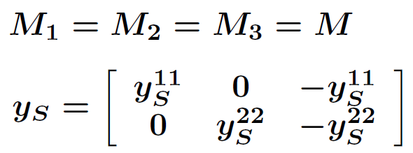
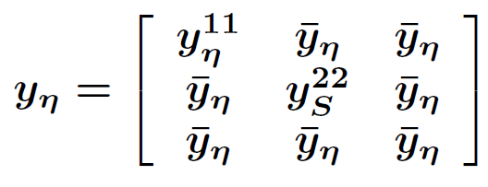
Assumptions
We consider the case with α =3 and set the following assumptions.
with

Slide 22
Assumptions
We consider the case with α =3 and set the following assumptions.
with
Electron mass

Slide 23
Assumptions
We consider the case with α =3 and set the following assumptions.
with
Muon mass

Slide 24
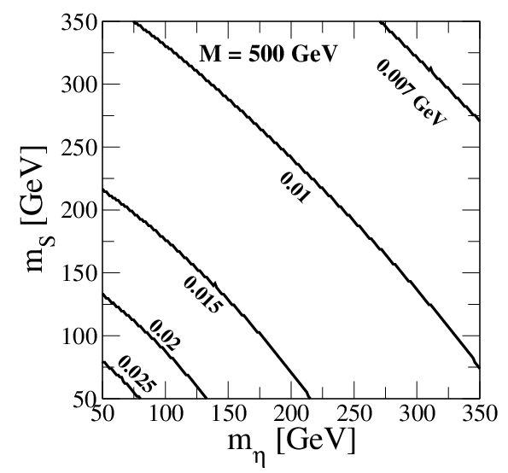
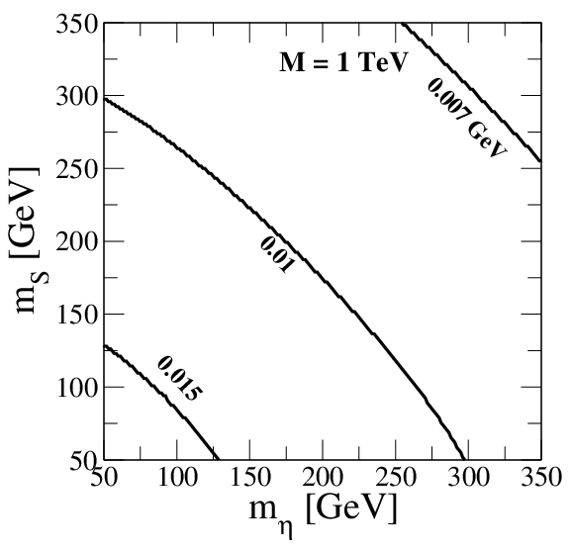
Contours for M
~
10 GeV

Slide 25
Contours for M
~
10 GeV
~0.05
~10

Slide 26
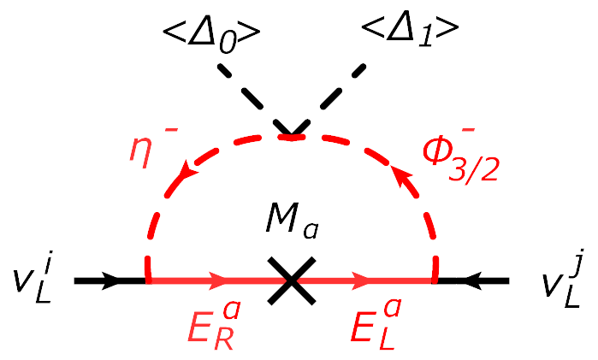
Neutrino Masses
Masses for E^{α}
Tauon mass
L#
×
L# violating coupling

Slide 27
Neutrino Masses
Masses for E^{α}
Tauon mass
L#
×
L# violating coupling
O(0.1) eV
~0.01 GeV
O(10⁻⁴)
O(10⁻⁴)

Slide 28
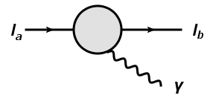
l → l γ Processes
New physics contribution
Δa_{ab} =
Diagonal elements: a=b
Muon g-2 (a=b=μ)
Electron g-2 (a=b=e)
Off-diagonal elements : a≠b
Lepton flavor violating process;
i.e., μ → eγ
Same assumptions are taken
as in the lepton masses
Δa_{ab} ∝ (M_{l})_{ab} = (M_{l})_{aa}

Slide 29
l → l γ Processes
New physics contribution
Δa_{ab} =
Diagonal elements: a=b
Muon g-2 (a=b=μ)
Electron g-2 (a=b=e)
Off-diagonal elements : a≠b
Lepton flavor violating process;
i.e., μ → eγ
Same assumptions are taken
as in the lepton masses
Δa_{ab} ∝ (M_{l})_{ab} = (M_{l})_{aa}

Slide 30
Muon g-2
The current measured value at BNL is given by
Bennett et al [Muon g-2 collaboration] Phys. Rev. D 73, (2006).
The deviation in a_{μ} from the SM prediction has been calculated by
Benayoun, David, Delbuono, Jegerlehner, Eur. Phys. J. C 72, (2012)..
4.3 σ deviation

Slide 31
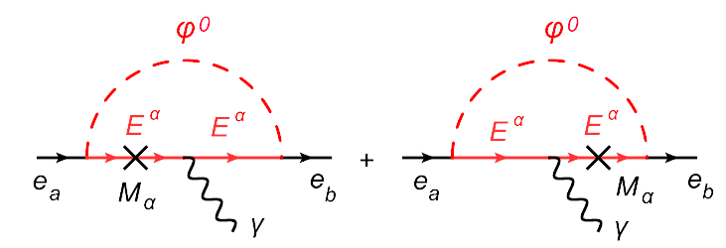
Muon g-2
We have new contributions to g-2 from the Z₂-odd particle loops.
φ⁰ are the neutral Z₂-odd
scalar bosons.
Δa_{μ} = Δa_{μμ} ~
∝ (M_{l})_{μμ} = m_{μ}
O(10⁻⁸)

Slide 32
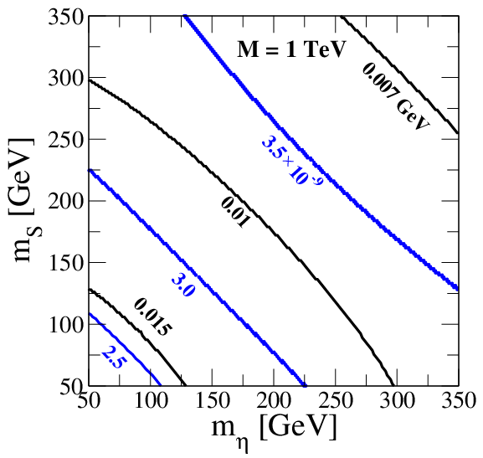
Muon g-2

Slide 33
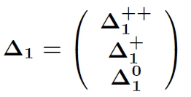
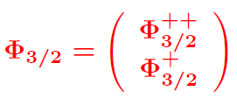
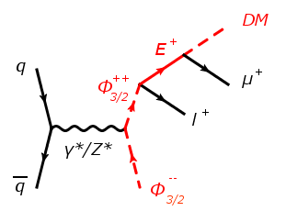
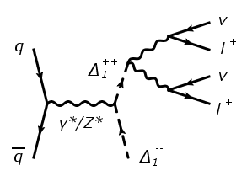
Higgs Phenomenology
There are two pairs of doubly-charged Higgs bosons;
Collider signatures from the doubly-charged Higgs bosons
C.-W. Chiang, T. Nomura, K. Tsumura (2012);
S. Kanemura, K.Y., H. Yokoya (2013).
W⁺
W⁺

Slide 34
Higgs Phenomenology
There are two pairs of doubly-charged Higgs bosons;
Collider signatures from the doubly-charged Higgs bosons
C.-W. Chiang, T. Nomura, K. Tsumura (2012);
S. Kanemura, K.Y., H. Yokoya (2013).
Charged lepton mass matrix
W⁺
W⁺

Slide 35
Summary
We have proposed the new mechanism to naturally explain
smallness of both masses for neutrinos and charged leptons and
the hierarchy between them.
Smallness can be explained by the loop suppression and triplet VEVs. The mass hierarchy can be explained by the number of triplet VEV.
Discrepancy in the muon g-2 can be explained due to the O(1) muon Yukawa couplings which is required to reproduce m_{μ}.
The lightest Z₂-odd scalar boson can be a dark matter candidate.
Collider phenomenology can be rich. We have two pairs of the doubly-charged scalar bosons from Δ₁ and Φ_{3/2}.

Slide 36
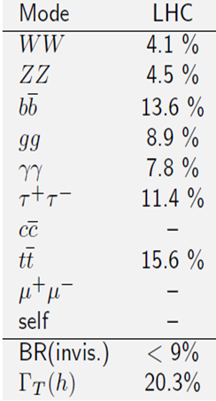
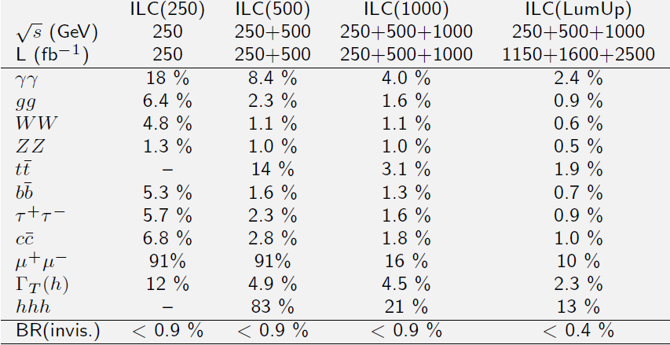
Higgs coupling measurements
ILC, TDR
ILC, Higgs White Paper, arXiv: 1310.0763
(300/fb)

