Slide 1
Goldstone Bosons in Condensed Matter System
Outline of lectures:
Examples (Spin waves, Phonon, Superconductor)
Meissner effect, Gauge invariance and Phase mode (GS boson)
Higgs mode (amplitude mode) in Superconductors
TexPoint fonts used in EMF.
Read the TexPoint manual before you delete this box.: AAAAAAAA

Slide 2
Condensed matter systems exist because of broken symmetries:
Translation, Rotation, U(1) gauge, etc
Goldstone theorem (’62):
“ breaking a continuous symmetry should cause massless excitations.
This is natural response of the system to restore the broken symmetry.”
Goldstone modes in CM:
Phonons (??), Spin-wave (‘40), phase mode in SC (‘57-60), CDW, etc
Goldstone mode in SC → Higgs mechanism (Meissner effect)
Higgs mode (amp. Mode) in SC → always exists but its observations are rare.

Slide 3
Goldstone modes are massless:
So, the energy dispersion relation E or  ~ k
In CM or in Nature, we have  ~ k and  ~ k²
Question (very important ) : what and/or how is the power  determined.
~ k may be more familiar, but  ~ k² is more natural
and  ~ k needs special condition.

Slide 4
Rotation symmetry SO(3) of spin & spin-wave
Ferromagnetism with J >0
Ground state with E₀=-J NS²
Low energy Excitations.
What is the E_{exc} ?
This is classical picture.

Slide 5
Lowest excitation, but not Eigenstate
Coherent superposition of |↓_{j} >

Slide 6
So, the Goldstone boson in Ferromagnetism has
We are familiar with E(k) ~k dispersion of the massless modes in rel. field theory.
What is the difference and origin for this ?
The same method has a difficulty to deal with

Slide 7
Quantization of Ferromagnetic spin-wave (Holstein-Primakoff method)
Consider this is a creation of a boson !
In each site, S_{i} has a definite S^{z} value

Slide 8
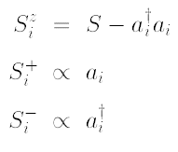
This mapping looks good.
→

Slide 9
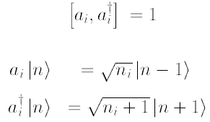
Spin commutation rules & Boson commutation rule slightly mismatch.
= 2(S-n)  1
Cure

Slide 10
Linear approximation !!
= 2(S-n)
~ 2S
Just the same result as before,

Slide 11
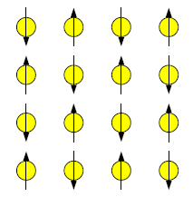
Now let us consider Antiferromagnetism.
Same Hamiltonian but J <0 → gs is different.
Not every site is the same.
There are A site & B site
Unit cell increases, BZ decreases.
“Doubling”
Creation and annihilation change its role in A and B sites.

Slide 12
Simple trick: Rotate all spins on B sites by 180 by S^{x} then,
Ferromagnetic case

Slide 13
Just like a SC (but with Boson) and A-B site symmetry → 2x2 mtx. diagonalization
“Doubling” makes k-linear dispersion naturally appear !!
Dirac Eq. has doubling : E² = p²+ m²

Slide 14
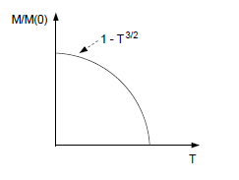
Ferromagnetic Goldstone boson:
Anti-Ferromagnetic Goldstone boson:
Spinwave dispersion
-π
π
-π
π

Slide 15
Superconductivity also has doubling in p-h states with fermions .
This is a quasi particle dispersion not a dispersion of Goldstone boson.
Goldstone boson in SC has indeed E(k) ~ k
We will come back to this question.

Slide 16
Acoustic phonon (Goldstone boson) dispersion : E(k) ~ k
Quantize :
Harmonic oscillator

Slide 17
Goldstone modes in CM are abundant .
They are massless.
In CM or in Nature, we have  ~ k and  ~ k²
Question (very important ) : what and/or how is the power  determined.
⬥ ~ k² is more natural
and  ~ k needs special condition → “Doubling”.

