Slide 1
Community Detection by Modularity Optimization Jooyoung Lee http://lee.kias.re.kr Center for in-silico Protein Science Korea Institute for Advanced Study Survey Science Group Workshop High1 Resort, Korea Feb 15, 2013
Network Science and Modules
What is Community Detection?
Community Detection by Modularity Optimization
Protein function prediction by community detection of a network

Slide 2
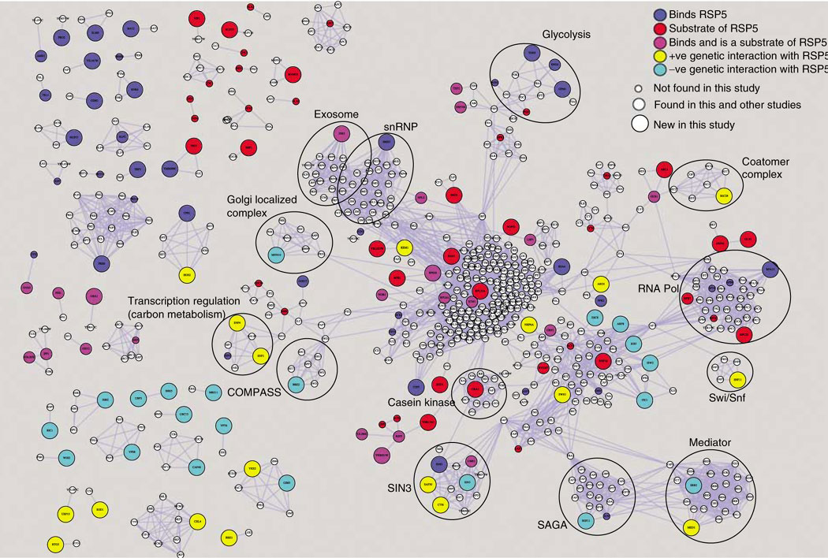
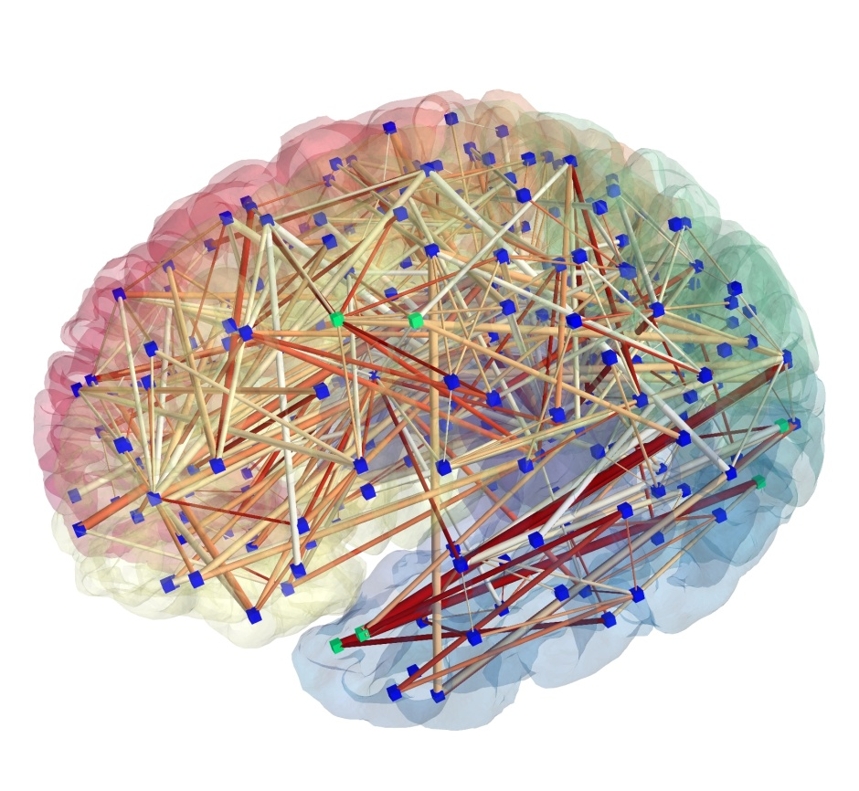
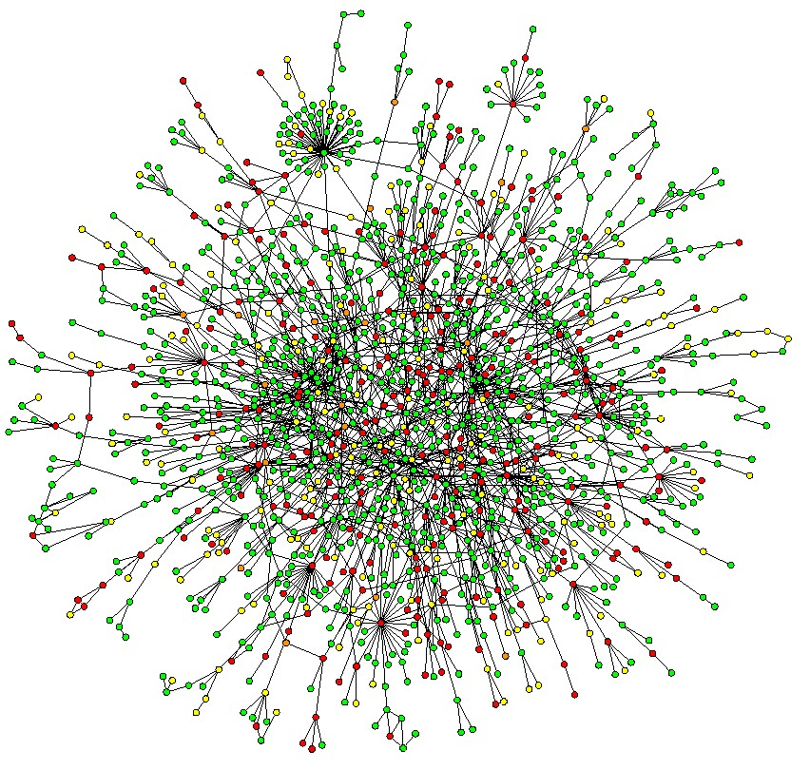
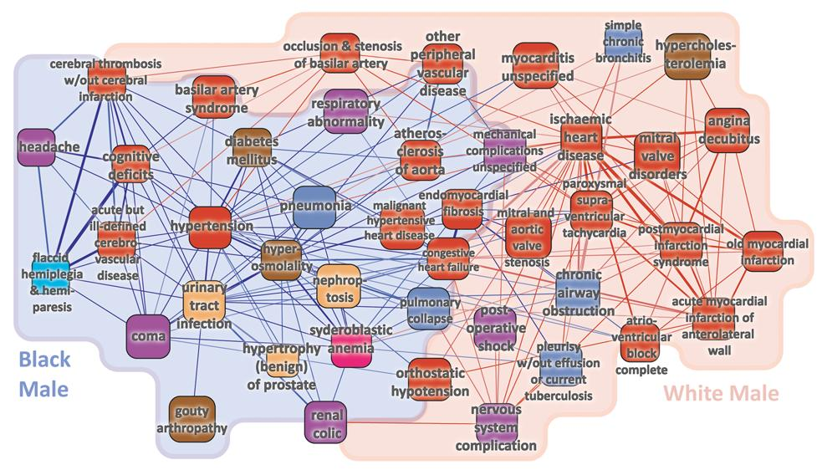
Notes:
For the decade, a network has become a important tool for studying complex biological systems
For example, Protein-Protein interaction network of yeast, brain network, metabolic network and disease network

Slide 3
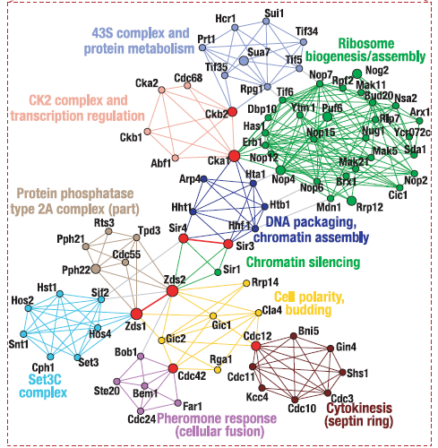
Communities (modules) in networks
Communities in yeast protein-protein interaction network
Biological networks are consisted of communities
Community
Module
Partition
Cluster
Functional modules
Protein complexes
Gene clusters
Notes:
Biological networks consist of communities.
Communities can also be called as module, partition or cluster
Existence of communities is a universal property of biological networks
Communities in biological network can be “Functional modules of proteins” or “Protein complexes” or “Gene clusters”

Slide 4
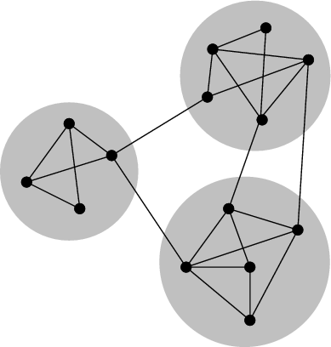
“Community/Module Detection” by Modularity Optimization
Divide a network into sub-graphs/modules
nodes are more densely connected internally
The most commonly used objective function to evaluate the quality of partition is Q proposed by Girvan and Newman

Slide 5
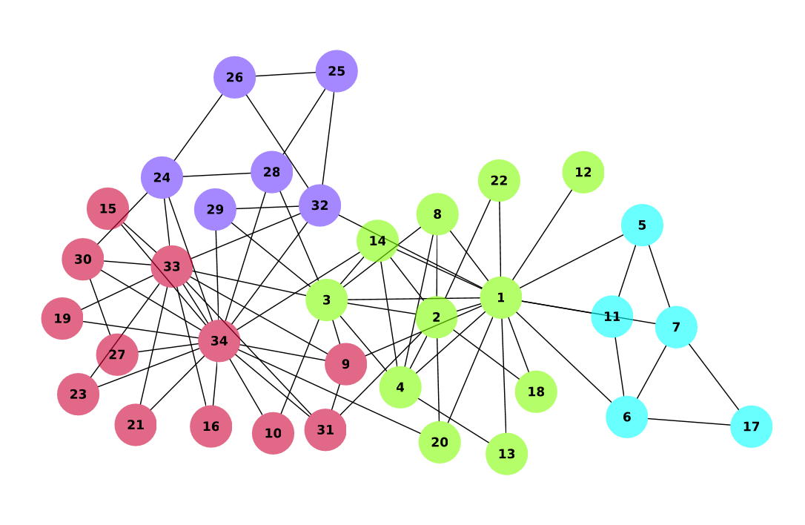
Which one is better?
Zachary’s karate club network
Friendship network of members
Q=0.420
Q=0.379
We need an objective function!
Notes:
Which partitioning do you think is better?
It is hard to determine at first glance
Therefore we need an objective function to judge

Slide 6
Two Issues with Modularity Q
(1) Difficulty of the problem:
Finding the best Q partition is a hard combinatorial optimization problem (NP-hard)
The current best stochastic optimization method is simulated annealing (SA)
(2) Relevance of the objective function:
Is a higher-Q solution more useful to extract hidden information from a network?
"So far, most works in the literature on graph clustering focused on the development of new algorithms, and applications were limited to those few benchmark graphs that one typically uses for testing" from Community Detection in Graphs (2010), Physics Report
Notes:
The first issue is about finding the maximum modularity.
It is well-known that community detection problem is NP-hard which means enumeration is impractical

Slide 7
Three Benchmark Tests of Q-Optimization
Notes:
We performed ~

Slide 8
Benchmark Test #1: LFR graphs
Networks are generated from known/assigned community structure.
More (less) edges are assigned between nodes within (between) a community.
We generate edges with a fixed mixing probability:
Mixing probability 0.1
10% of inter-community edges
90% of intra-community edges
Notes:
LFR benchmark graph is a network with known community structure.
Based on known communities of nodes, edges are generated with a mixing probability
For example, if mixing probability is 0.1, 10 percent of edges are generated between communities and 90 percent of edges are generated inside the community.

Slide 9
Mixing probability = 0.1
Notes:
This is a visual example of a LFR network with mixing probability 0.1
And community structures are easily identified.

Slide 10
Mixing probability = 0.6
Notes:
This is an example of network with mixing probability of 0.6
And communities are not easily identified, which means the problem gets more difficult than the previous one.

Slide 11
Test on LFR graphs 50 simulations of CSA and SA (PRE 85, 056702 (2012)
Mixing Prob. | Modularity | Accuracy | t_{CSA}(sec) | t_{SA}(sec)
 | <Q_{CSA}>/<Q_{SA}> | <ACC_{CSA}>/ <ACC_{SA}>
0.10 | 0.8638 / 0.8638 | 0.9994 / 0.9994 | 107.5 | 2422.4
0.20 | 0.7585 / 0.7585 | 0.9990 / 0.9990 | 100.4 | 4095.3
0.30 | 0.6641 / 0.6641 | 0.9974 / 0.9974 | 128.1 | 3596.5
0.40 | 0.5641 / 0.5639 | 0.9936 / 0.9926 | 175.1 | 4784.9
0.50 | 0.4675 / 0.4665 | 0.9705 / 0.9675 | 276.4 | 8350.1
0.60 | 0.3711 / 0.3691 | 0.8671 / 0.8545 | 699.2 | 94170.1
Higher modularity and more accurate partitions are obtained using less computational time (only ~5%)
Notes:
This table shows the benchmark result obtained by CSA and SA simulations.
Since both methods are stochastic, We performed 50 iterations for each method
We performed tests with a number of benchmark graphs with different mixing probabilities.
The second column shows modularities
And the third shows the accuracy which means how many nodes are correctly classified compared to the answer.
The last two columns show computational time.

Slide 12
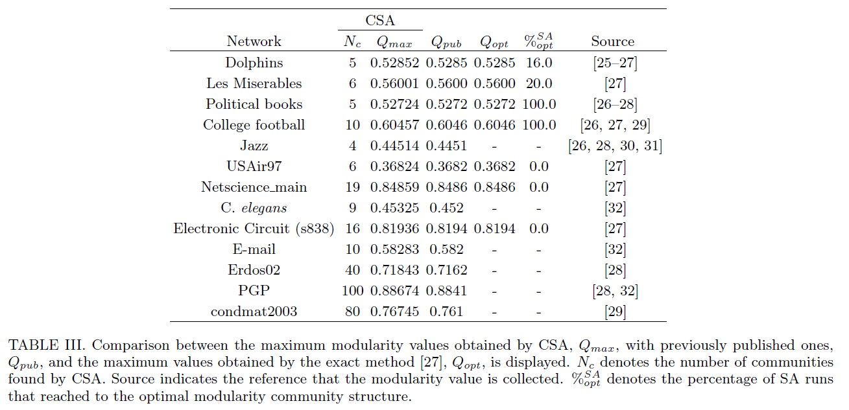
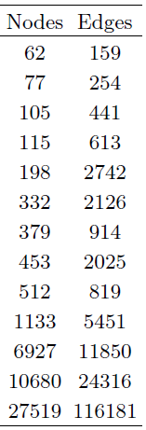
Benchmark Test #2: real-world networks
PRE 85, 056702 (2012)

Slide 13
Conclusions
We developed a highly efficient modularity optimization method by using CSA
Higher modularity partitions are functionally more coherent
We developed the first module-assisted function prediction algorithm which outperforms neighbor-assisted methods
Extracting maximal information from network topology itself
Our method is general and can be applied to other networks

Slide 14
Acknowledgements
Community Detection: Juyong Lee (KIAS, NIH)
Steven Gross (UC Irvine)
Cluster computers: KIAS/CAC
Supported by the Korea Science and Engineering Foundation (KOSEF) grant funded by the Korean government (MEST) (No. 2009-0063610)
Postdoc/Researcher Positions Available

