Slide 1
Dark Energy Probes with DES (focus on cosmology)
Seokcheon Lee (KIAS)
Feb.15.2013
Section : Survey Science III

Slide 2
Outline
The Dark Energy Survey (DES)
DECam
Survey
Supernovae
Baryon Acoustic Oscillations (refer 최윤영)
Cluster Numbers
Weak Lensing (refer 탁윤찬, 박명구)
Forecast

Slide 3
The Dark Energy Survey
Aims : probe both background evolution and the growth of LSS (reason p.5)
Collaboration : Brazil, Germany, Spain, UK, and US (led by Josh Frieman)
4m Victor M. Blanco Telescope @ Cerro Tololo Inter-American Observatory (CTIO) in Chile (new camera DECam)
5000 sqr deg of southern sky
From Dec. 2012 to Dec. 2017

Slide 4
Dark Energy Investigation
systematics
Growth of structures
Observational Quantities
Standard rulers
Clusters
Weak lensing
Acoustic oscillations
SNe Ia
+ SZ + WL calibration
3D reconstruction
transverse (2D)
geometric test
transverse + radial (3D)
Tomography
+ Planck CMB
+ Planck CMB
+ Planck CMB + SDSS
20%
20%
Photometry
z = 1
10%
10%
+ Planck CMB
+ Planck CMB
Accuracy on w
+ SNe
5%
+ Planck CMB
+ Planck CMB
5%
Spectroscopy
z=1 and z = 3
1-2%
1-2%
2015
2015
2009

Slide 5
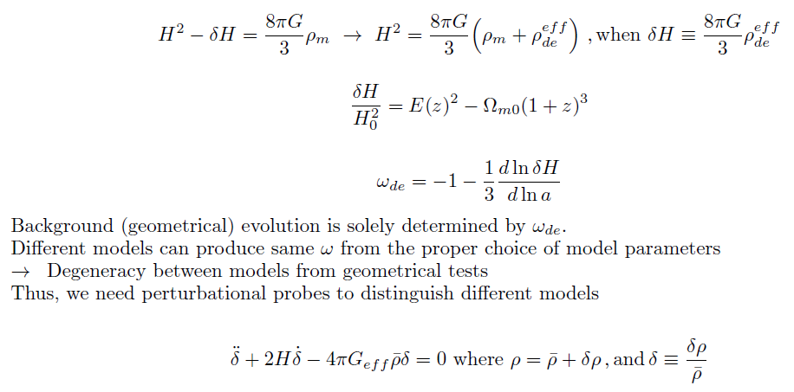
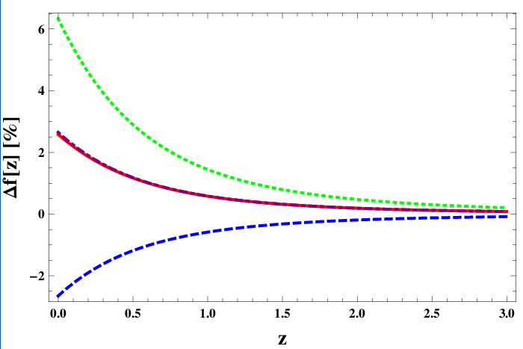
Degeneracy in Background evolution can be cured by Perturbation
Need to have about 2% accuracy
Can rule out Cardassian type
Removing degeneracy

Slide 6
DECam I
Efficiency in red part of visible spectra and in NIR.
Current CCD at Victor M Blanco Telescope has high efficiency for blue light
Important for observation of very distance sources, like SNe Ia and Clusters
Si (main source of CCDs) transparent for IR light (refer 박수종)

Slide 7
DECam II
Consists of three major components : CCDs, mechanics, optics
CCDs : 62 2048 X 4096 pixel CCDs totaling 520 megapixels + 12 2048X2048 CCDs to guide telescope, monitor focus and alignment
The additional crystal depth increases the path length travelled by entering photons. This increases the probability of interaction and allows the CCDs to have an increased sensitivity to lower energy photons, extending the wavelength range to 1050 nm (refer 박창범, ngCFHT 1300nm, 정웅섭, 표정현)
Each pixel has a width of 0.27“ on the sky, this results in a total field of view of 3 square degrees

Slide 8
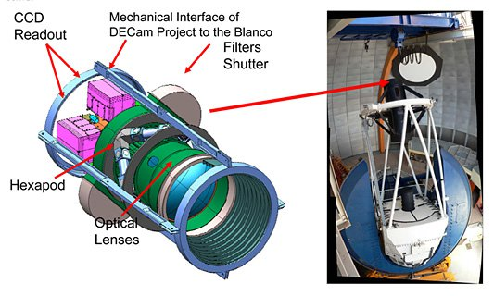
DECam III
Mechanics : consists of a filter changer with an 8 filter capacity and shutter
The entire camera with lenses, filters, and CCDs weighs approximately 4 ton
Optics : outfitted with g,r,i,z,y filters similar to SDSS (refer 홍성욱)
allow DES to get photometric redshift measurements to z ~ 1 using 4000 A break for galaxies

Slide 9
SNe Ia
Standard candles (same absolute brightness) : 3000 SNe z~1 30 sqr deg

Slide 10
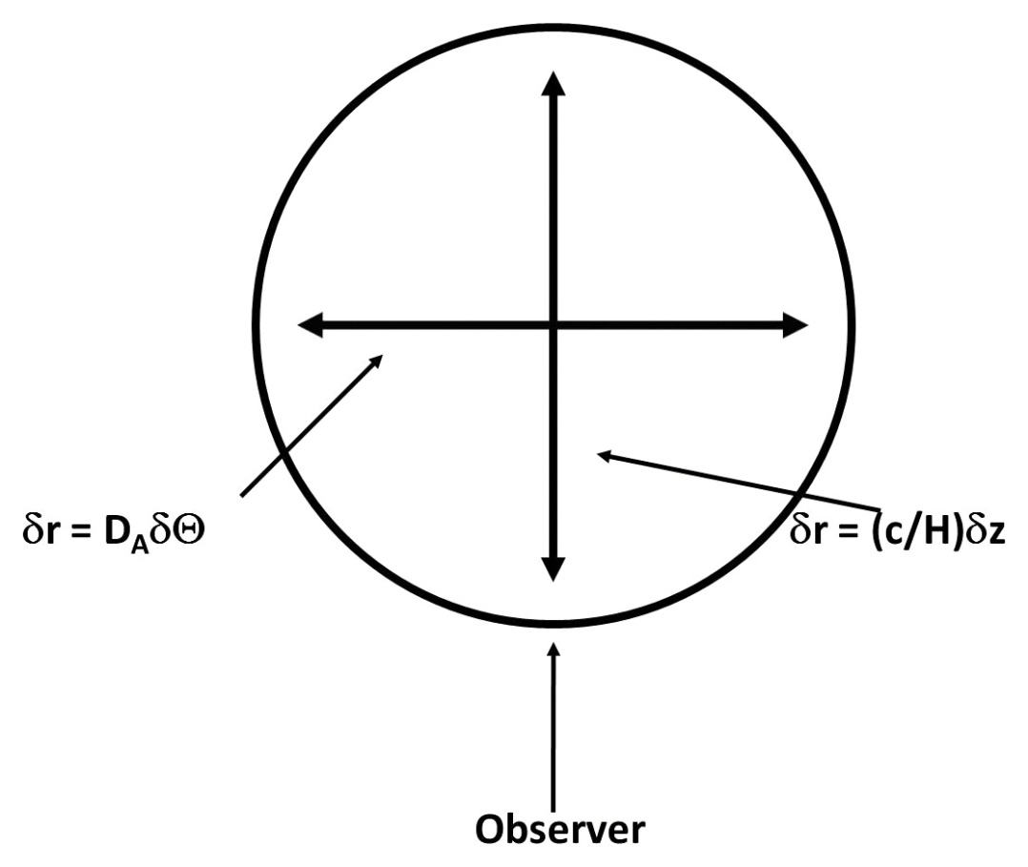
BAO
Standard ruler : measure both H and D_A
300 million galaxies, Δz ~ 0.08 , z ~1.4 (20 times bigger than SDSS photometric LRGs)

Slide 11
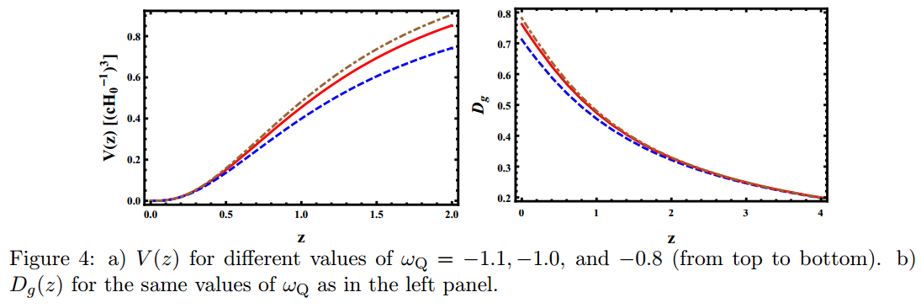
CL I
DE effects on Growth factor and Volume (SL & Ng 10)
comoving number density of virialized objects

Slide 12
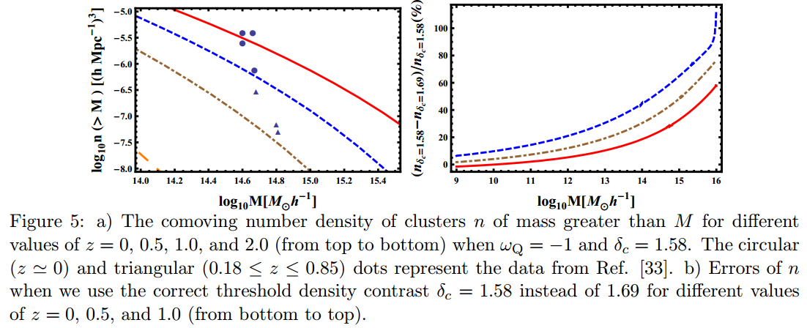
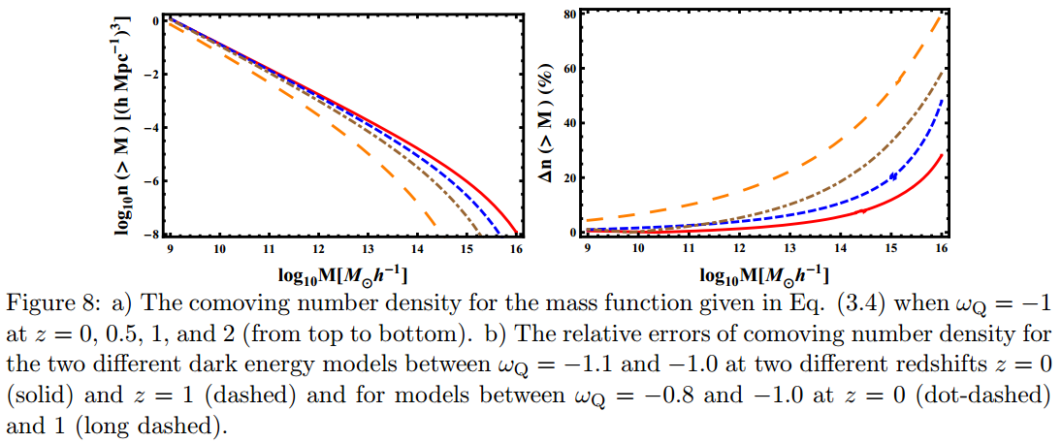
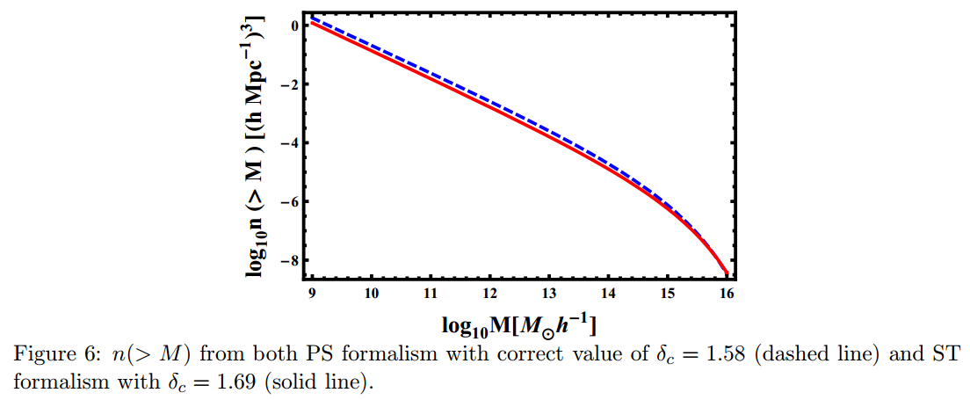
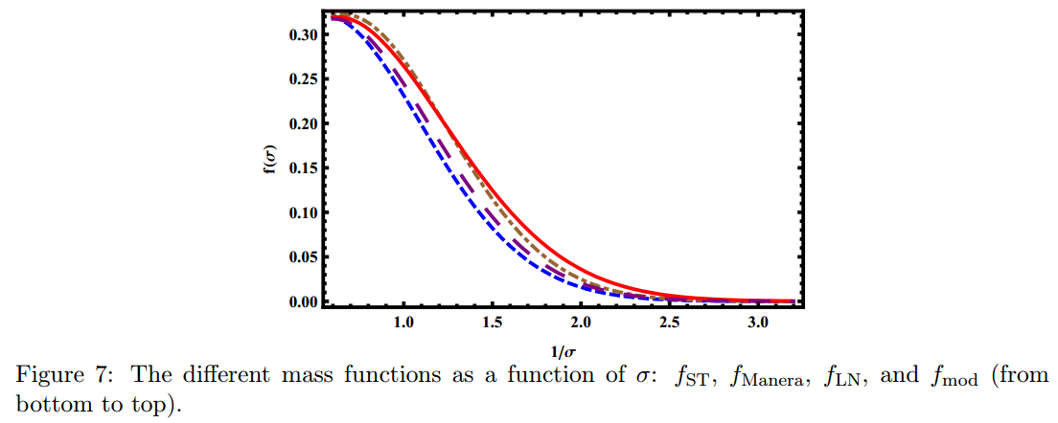
CL II
Results (data from Calberg et al 96)

Slide 13
CL III
DES M > 5*10^13 M_s
z = 1.5

Slide 14
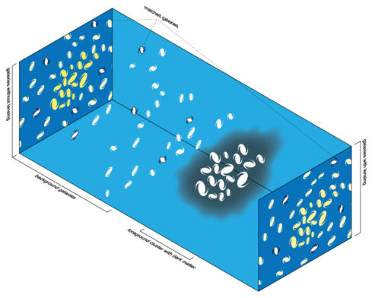
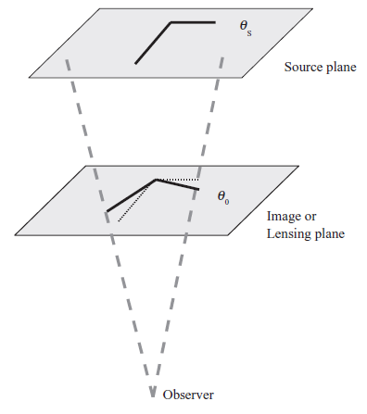
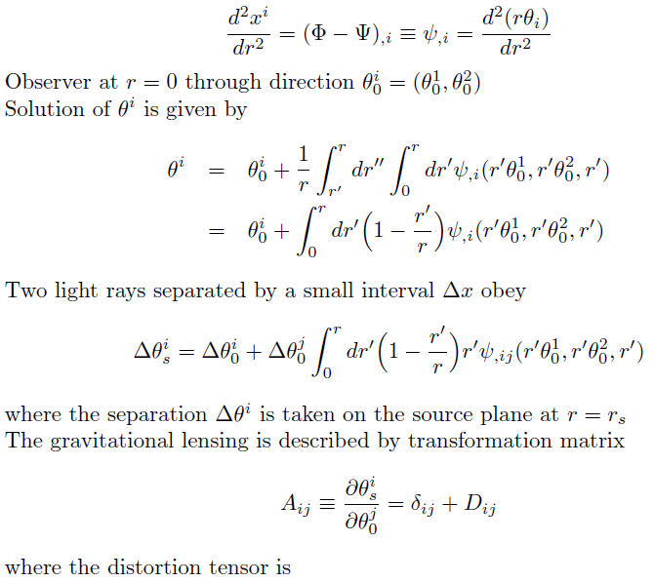
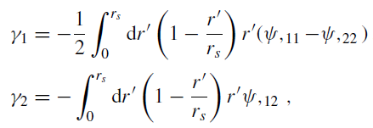
WL I
Due to total matter distribution (not only luminous one which needs bias factor)

Slide 15
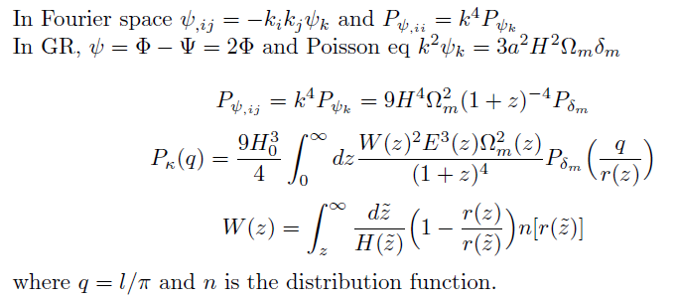
WL II
We can investigate cosmology by using power spectra of convergence and shear field

Slide 16
WL III
Distortion of images of galaxies referred to cosmic shear is too small to be measured for an individual galaxy
Shear power spectrum as a function of photometric redshift

Slide 17
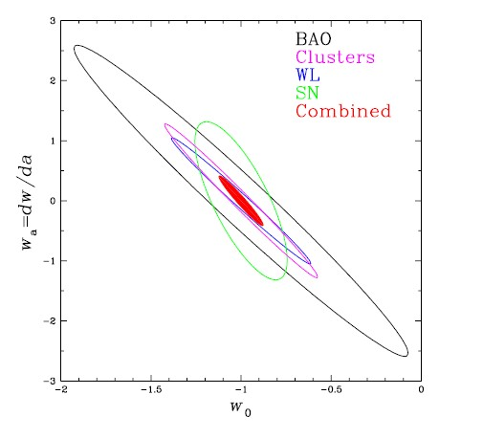
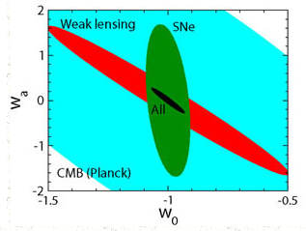
Conclusion
Forecast

