Slide 1
Purification of Liquid Scintillators for Low Radioactivity
Frank Calaprice
Princeton University
Borexino Experiment

Slide 2
Liquid Scintillator Radioactivity
Extreme scintillator radio-purity is essential for solar neutrino measurements.
Initial Borexino data on ⁷Be, ⁸B, and pep solar neutrino data relied on process equipment developed in the 1990’s.
Distillation
Water extraction
Nitrogen stripping
Better accuracy on⁷Be, ⁸B, and pep solar neutrinos and possible measurement of pp and CNO neutrinos motivate a second phase of Borexino with lower backgrounds.
A new campaign of re-purification to achieve lower backgrounds for a second phase of Borexino started in 2010.

Slide 3
Requirements for Low Radioactivity Scintillator
Effective scintillator purification processes
Efficient removal of radioactive elements
Development of cleaning methods to remove radioactivity from equipment surfaces.
Purification of scintillator before and after filling detector.
Radio-pure containment vessel
Low bulk radioactivity
Low surface radioactivity

Slide 4
History
Thin nylon scintillator vessel and scintillator purification technologies were developed at Princeton University in the 1990’s.
1990-1996
Counting Test Facility (CTF) purification system
Demonstrated feasibility of low background scintillator
Reference: J.B. Benziger, et al, “A scintillator purification system for a large scale solar neutrino experiment”, NIM A 417, 278 (1998)
1998-2002
Full-scale purification system.
Reference: J. Benziger, et al , “A scintillator purification system for the Borexino solar neutrino detector” NIM A 587, 277 (2008).
Borexino Vessels developed.
Reference: J. Benziger, et al, “The nylon scintillator containment vessels for the Borexino solar neutrino experiment, NIM A 582, 509 (2007).

Slide 5
Borexino Vessel Filling Strategy
Vessels inflated with high purity synthetic air.
Vessels filled with de-ionized water.
Recent results suggest water may have been a mistake.
Scintillator distilled during filling.
Scintillator filled with scintillator from top, while draining water from bottom.

Slide 6
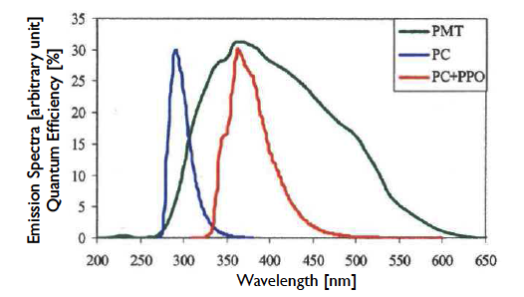
Scintillator Components
Tri-methyl benzene
PPO
DMP

Slide 7
Purification Procedure for Borexino Scintillator (PC+1.5 g/l PPO)
PPO wavelength shifter was purified by preparing a concentrated “master solution” of PPO dissolved in pseudocumene (PC).
The master solution was purified by a combination of water extraction followed by distillation.
PC was shipped to temporary storage vessels, then distilled and mixed with PPO master solution while filling the vessels.

Slide 8
Borexino Purification System Initial Filling detector

Slide 9
Scintillator Purification Plants
Distillation, water extraction, and nitrogen stripping of PC at 1 m³/hr
Distillation of concentrated PPO+PC in CTF purification plant at 20 liters/hr
Low-Argon-Krypton (LAK) N₂ gas for stripping.
After fabrication all equipment was sent to special firm for “precision cleaning”.
After cleaning, th equipment was opened and assembled in a “radon-free” cleanroom.

Slide 10
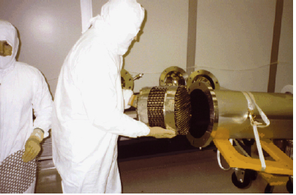
6-tray distillation column and gas stripping column with packing.
Assembly was done in Princeton
radon-suppressed cleanroom.

Slide 11
Purification of PPO Wavelength Shifter

Slide 12
Borexino Energy Spectrum (BX3) Phys. Rev. Letts. 107 141302 (2011)

Slide 13
Nylon Scintillator Vessel
Low radioactivitiy scintillator required development of a low radioactivity nylon vessel container.
Low total radioactivity
Thin nylon file 120 micron thickness
Low bulk radioactivity [U], [Th] ~ 1 ppt
Careful selection of pellets
Special extrusion to reduce air contamination
Low surface radioactivity
Fabrication in special Class-100 clean room constructed at Princeton University to eliminate particulate (dust).
Hermeticlly sealed clean room with low radon air.
Sealed, shipped to Italy, then inflated with synthetic air in clean room air of Stainless Steel Sphere.

Slide 14
Borexino Re-Purification Systems Options for Water Extraction or Distillation followed by Nitrogen Stripping

Slide 15
Results of 6 cycles of Re-purification
⁸⁵Kr: 30 cpd/100t → < 5 cpd/100t
²¹⁰Bi: 70 cpd/100t → 20 cpd/100t
²¹⁰Po: Essentially unchanged (?)
²³⁸U (²²⁶Ra): < 9.7 x 10⁻¹⁹ g/g
This is a spectacular result with < 1 ct/yr/100t of ²¹⁴Bi-²¹⁴Po delayed coincidences observed!
²³²Th: < 2.9 x 10⁻¹⁸ g/g

Slide 16
General Comments 1. Nitrogen Stripping
Nitrogen stripping removed ⁸⁵Kr very well.
The column was designed properly.
The upper limits of ³⁹Ar and ⁸⁵Kr in nitrogen was calculated in advance using standard chemical methods.
Methods to measure the argon and krypton in nitrogen were known.
Measurements were made to meet the requirements.

Slide 17
Low ³⁹Ar and ⁸⁵Kr (LAK) Nitrogen H. Simgen, G. Zuzel LRT 2006
Measurement techniques:
Noble gas mass spectrometry.
Low background gas proportional counter
Borexino Requirements:
⁸⁵Kr: < 0.2 μBqm³
³⁹Ar: < 0.6 μBq/m³
Tested European Suppliers and delivery system.

Slide 18
General Comments 2. Water Extraction
²³⁸U reduced by factor >15 (²¹⁴Bi-Po actually ²²⁶Ra)
²³²Th reduced by factor >3 (²¹²Bi-Po)
²¹⁰Pb reduced by factor of ~4
²¹⁰Po not reduced.
The water extraction column was designed well, but…
The system to distill and re-use water had a flaw that required a change in procedure to drain wastes properly. The change was implemented for last 2 operations, which gave the best performance.
Studies of the water plant after the operations indicate high levels of ²¹⁰Pb, and especially ²¹⁰Po, in the water that contacts the scintillator.
The ²¹⁰Pb and ²¹⁰Po are produced by ²²²Rn in ground water.
De-ionization processes are not very effective for removing Pb and Po.
Distillation is needed, but may have to contend with volatile compounds of Po.

Slide 19
Summary of Scintillator Re-Purification
Successful Water Extraction & N₂ Stripping
⁸⁵Kr, ²³⁸U (²²⁶Ra), ²³²Th, ²¹⁰Pb reduced.
Failure to reduce ²¹⁰Po significantly.
Discovery of radon daughters in de-ionized water at levels of 1-100 mBq/m³
New processes and equipment are being developed for more efficient removal of Pb and Po from water.
A productive second phase of Borexino looks promising.

Slide 20
Conclusions
Initial filling of Borexino gave low background except for ²¹⁰Po, which was very high.
Recent studies of the water show that de-ionzation processes are not effective for removing ²¹⁰Po, and poor for removing ²¹⁰Pb.
Thus, filling Borexino with water first may have caused the high level of ²¹⁰Po.
Nitrogen stripping and water extraction are convenient for re-purification of multi-component scintillator, compared to distillation.
⁸⁵Kr removed well, and ²¹⁰Pb, to some extent, ²¹⁰Po, not well.
Removing the radon daughters from the water supply should help toward efficient removal of ²¹⁰Pb and ²¹⁰Po by water extraction.

Slide 21
Water Extraction System
Water is supplied by BX Water Plant (see M. Giammarchi talk).
Single stage evaporator (E201-V201) produces steam that is condensed into V202.
Water from V202 flows into top of packed column C200 and returns to V201.
Scintillator enters bottom of C200, flows upwards against water and exists at top.
10% of water is wasted out bottom of E201-V201 at same rate as make-up water is added.
Waste design is flawed.

Slide 22
Spares

Slide 23
Re-Purification of BX Scintillator 2010-2011
From 2007 to 2010 the ²¹⁰Bi background increased
Causes: Scintillator refill operations to cope with vessel leak. Other?
²¹⁰Bi rate: 15 → 70 cpd/100t
⁸⁵Kr rate: 30 cpd/100t (constant)
To reduce background, scintillator was re-purified using two processes:
Water extraction to remove ²¹⁰Pb (²¹⁰Bi)
Nitrogen stripping to remove ⁸⁵Kr and other volatiles.
Distillation was deferred to develop a new distillation system for PPO.
Six purification operations were done, each of ~1 month duration.
Each operation processed all the scintillator in the detector once (320 m³).
Data were acquired to evaluate backgrounds after each operation.
Not all six operations were successful.

Slide 24
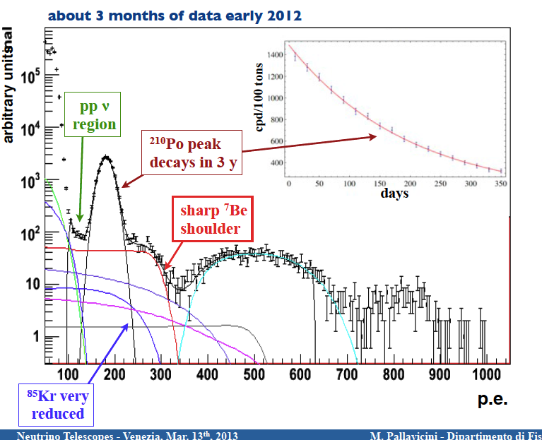
Energy Spectrum after Re-Purification

